Slide 1

PRESENTATION ON HOSPITAL TRAINING-II SUBJECT CODE: BP-707P
Presented by Presented to
Sarafraj Ansari Mr. Virendra Kumar Singh
B.pharm 4th year BNCP, Lucknow
Roll no. 2109190500051
B.N.COLLEGE OF PHARMACY, LUCKNOW

Slide 2
CONTENTS
Objectives of Training
Introduction
Departments
Work Profile
Conclusion
References

Slide 3
Objectives of Training
To study the hospital structure.
To know about its product and service activities.
To know the different functions of the departments.
To know the responsibilities of top management and how to execute responsibility.
To analysed the working of hospital using by analysis of various departments.

Slide 4
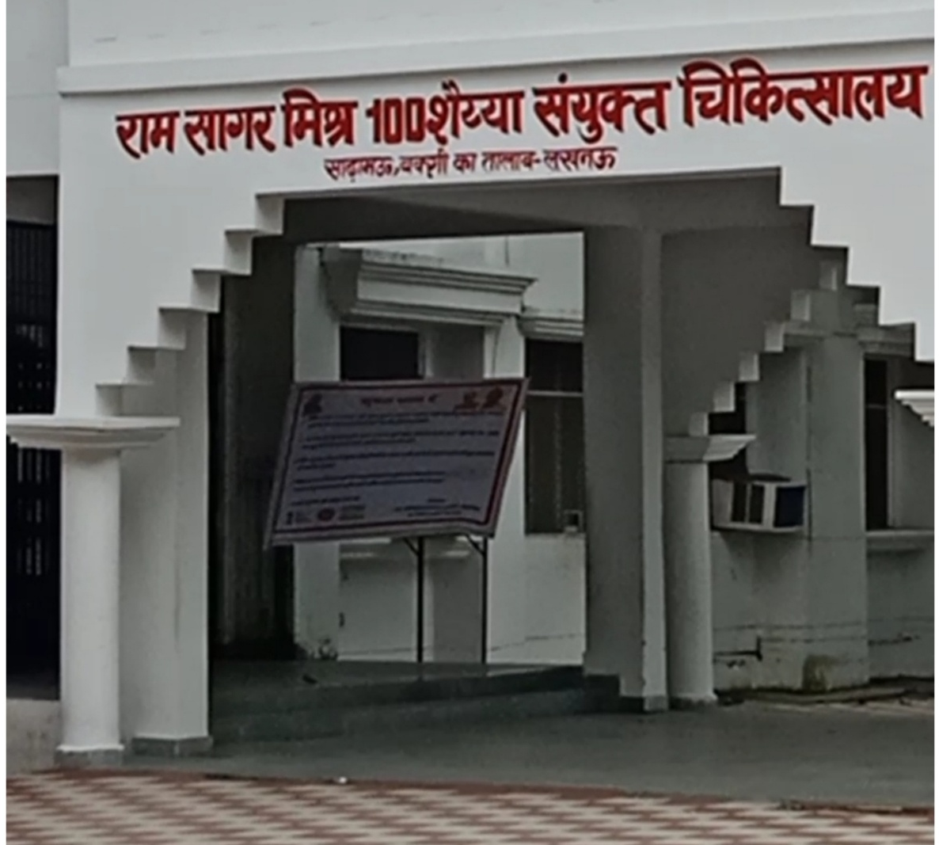
INTRODUCTION
I completed my training at RAM SAGAR MISHRA 100 BEDDED COMBINED HOSPITAL This hospital is a government recognized hospital.
A health care center or health center or community health center is one of the network of clinical staffed by a group of general practitioner and nurses providing health care services to people in a certain area
Figure no.1

Slide 5
Departments
Dressing Room
Out Patient Department (O.P.D.)
Intensive Care Unit (I.C.U.)
Emergency Ward
Dispensing Room
Pathology

Slide 6
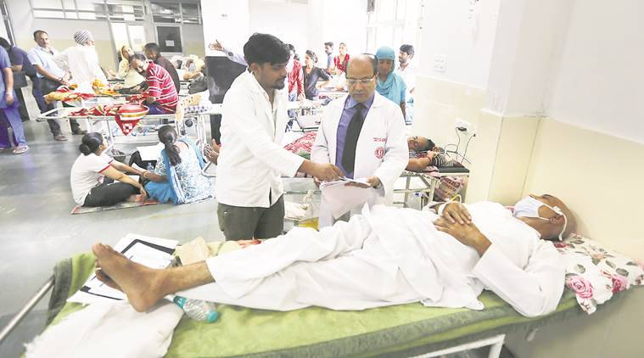
Emergency Ward
Modern emergency departments are managed by qualified emergency physicians and nurses, trained specifically for providing emergent care to save a life.
Emergency ward is the first point of contact for any critically ill patient, needing immediate medical attention.
Figure No.2 Emergency Ward

Slide 7
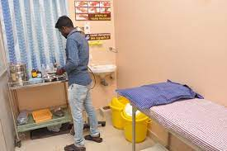
Dressing Room
A dressing is a sterile pad applied to a wound to promote healing and protect the wound from further harm.
A dressing is designed to be in direct contact with the wound, as distinguished from a bandage, which is most often used to hold a dressing in place.
Figure No.3 Dressing Room

Slide 8
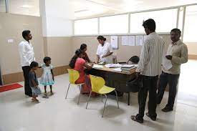
Out Patient Department
OPD is defined as a part of the hospital with allotted physical facilities and medical and other staffs, with regularly scheduled hours, to provide care for patients who are not registered as inpatients.
A hospital department where patients receive diagnosis and/or treatment but do not stay overnight.
Fig. No.4 Out Patient Department

Slide 9
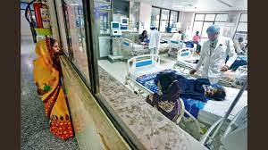
Intensive Care Unit
Intensive care unit (ICU) refers to a place where specialized treatment is given to patients who are acutely unwell and need special attention and support.
It provides critical care and life support for acutely ill and injured patients.
Fig. No.5 Intensive care unit

Slide 10
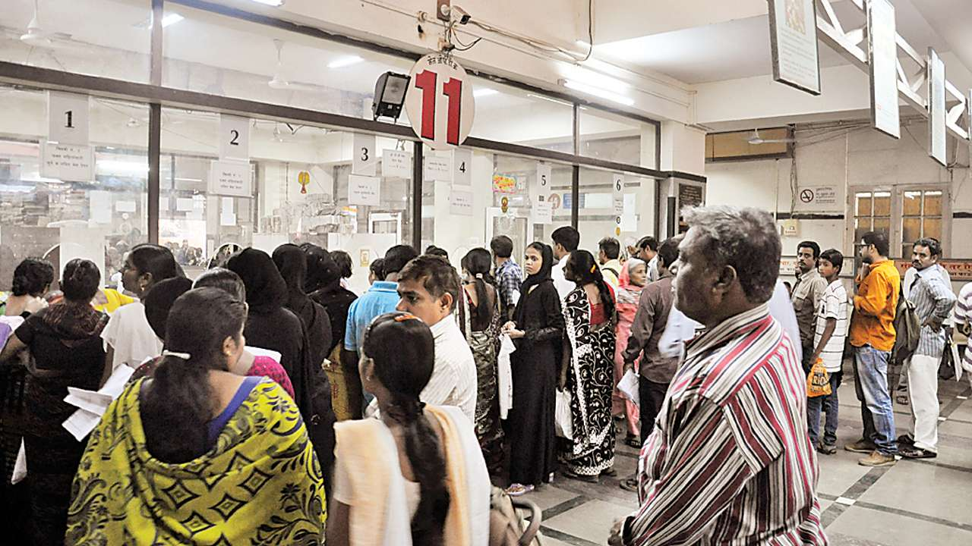
Dispensing Room
A dispensary is the room or area in a hospital where medicine is given out to patients according to their prescription.
A dispensary is often run by a pharmacist, doctor or nurse who is authorized to dispense medicine that is paracetamol, azithromycin, salbutamol , aspirin etc
Fig. No.6 Dispensing room

Slide 11
Work Profile
I have completed my training at community health center for 45 days. During this training worked in different-different department like emergency ward, surgical ward, dispensary etc.
During this training period, came to know that how to dispense medicines to the patients, how to inject injection to them, how to handle trauma and emergency cases.
Duty Time – 02:00PM to 08:00PM

Slide 12
CONCLUSION
Hospital training learned about first aid, first aid includes various things such as wound dressing, artificial respiration, blood pressure maintenance, etc. The first aid treatment varies according to the type of injury like burn, shock, bone fracture, wound, etc.
There i got training of administration of injections via various routes and precautions that must be taken while administration of injection.
I have learned as how to handle prescription & dispensing the medicine.

Slide 13
REFERENCES
https://www.medicopharma.com
https://en.apollomedics.com
https://www.brainly.com
https://www.vocabulary.com › dictionary › dispensary

Slide 14
THANK YOU

